Slide 1

E-commerce Data Visualization platform
Ting Wei
Xinchen Yang
Huang Jin
23May. 2023
Notes:
Wiem, że robiliście tak żeby fioletowy nie gryzł się z szarym, ale czerń i szarość przytła

Slide 2
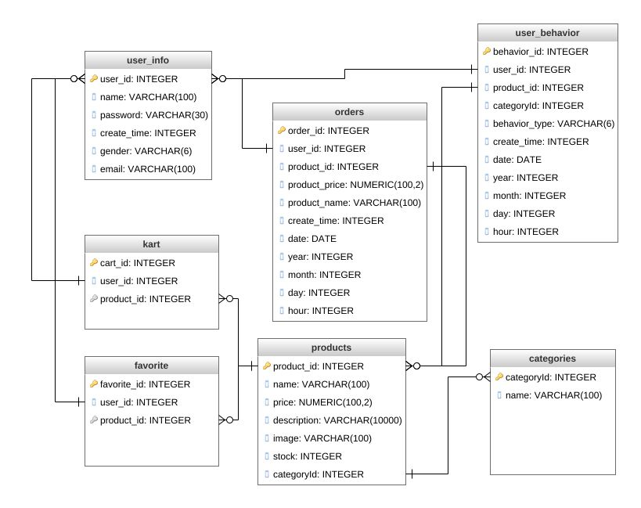

Databases of Visualization platform

Slide 3
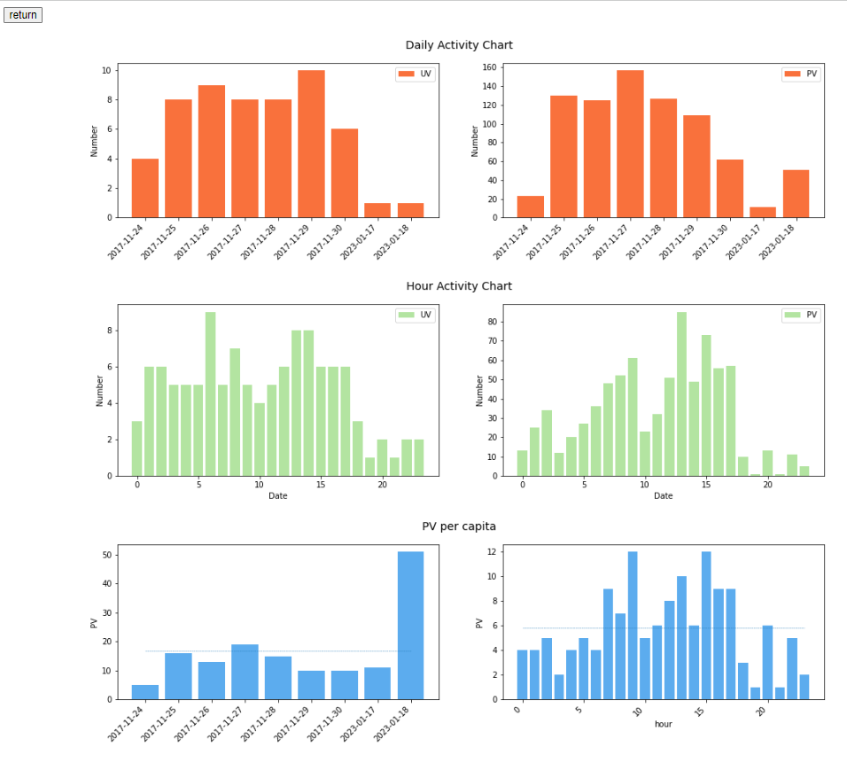
Consumer Activity Analysis
Bibliography
O projekcie
R

Slide 4
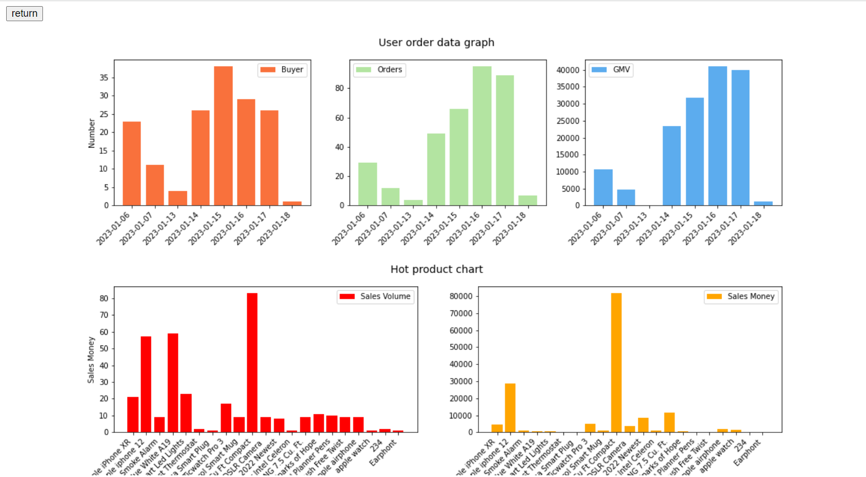
Consumer Order Analysis
Bibliography
O projekcie
R

Slide 5
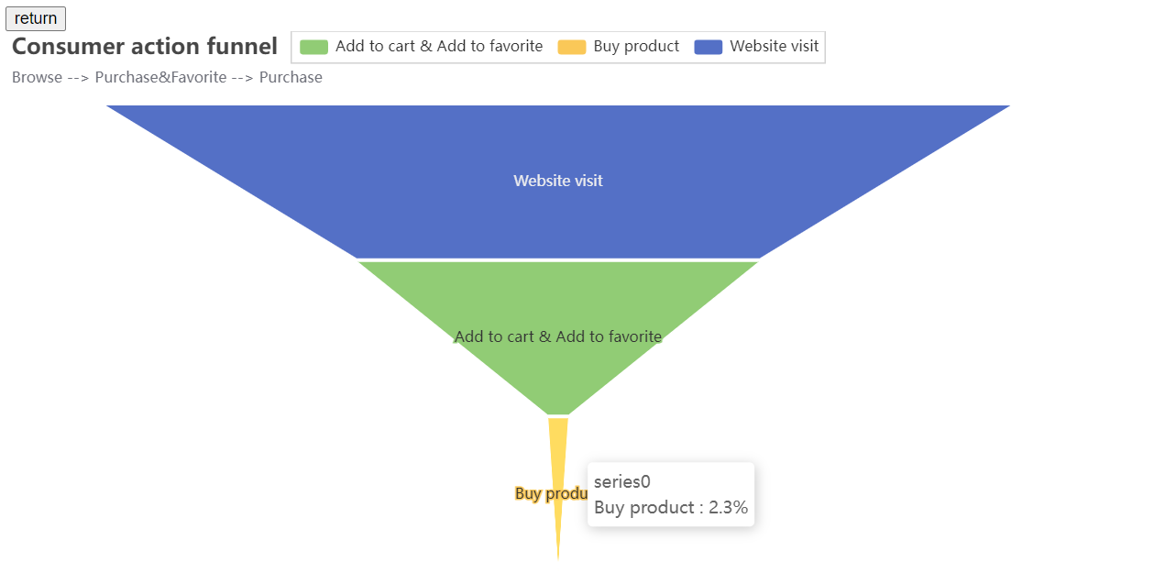
Conversion rate using funnel model 01
Bibliography
O projekcie
R
Browse → Add to Cart &Favorite → Purchase
Action conversion rate

Slide 6
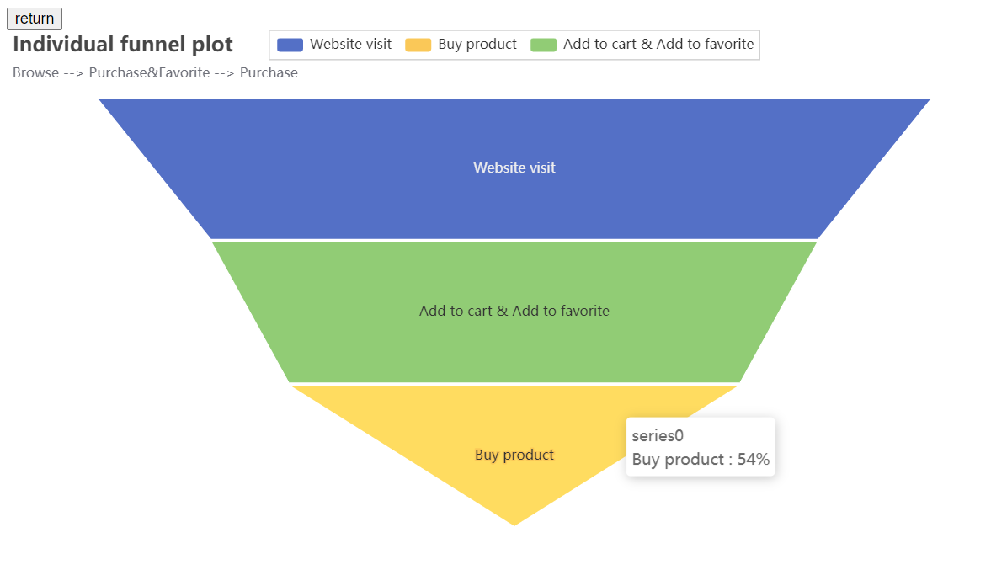
Conversion rate using funnel model 02
Bibliography
O projekcie
R
Browse → Add to Cart &Favorite → Purchase
Individual conversion rate

Slide 7
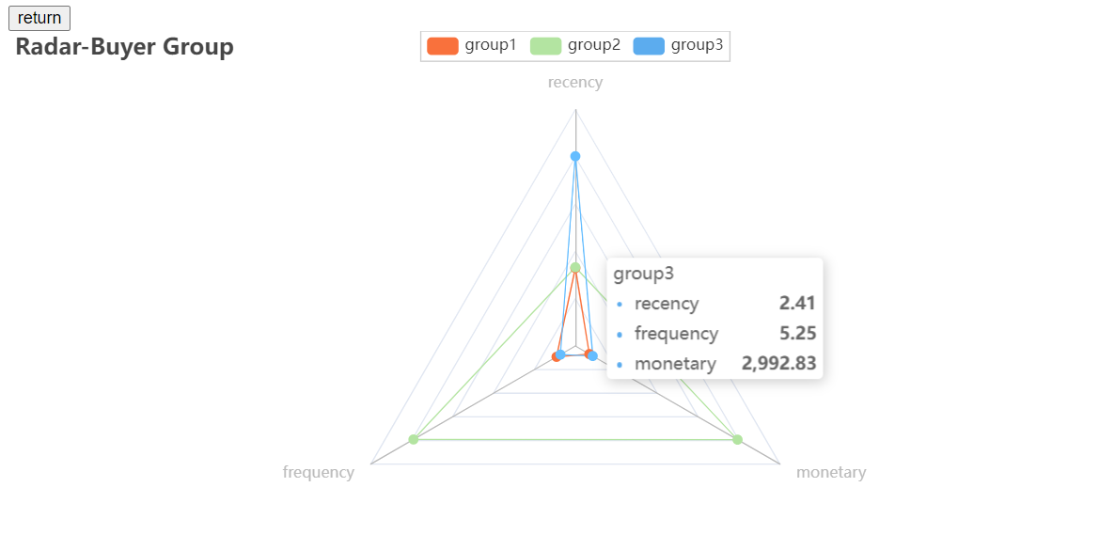
Consumer Segmentation using K-Means and RFM
Bibliography
O projekcie
R
Recency. How recent was the customer's last purchase?
Frequency. How often did this customer make a purchase in a given period?
Monetary. How much money did the customer spend in a given period?

Slide 8
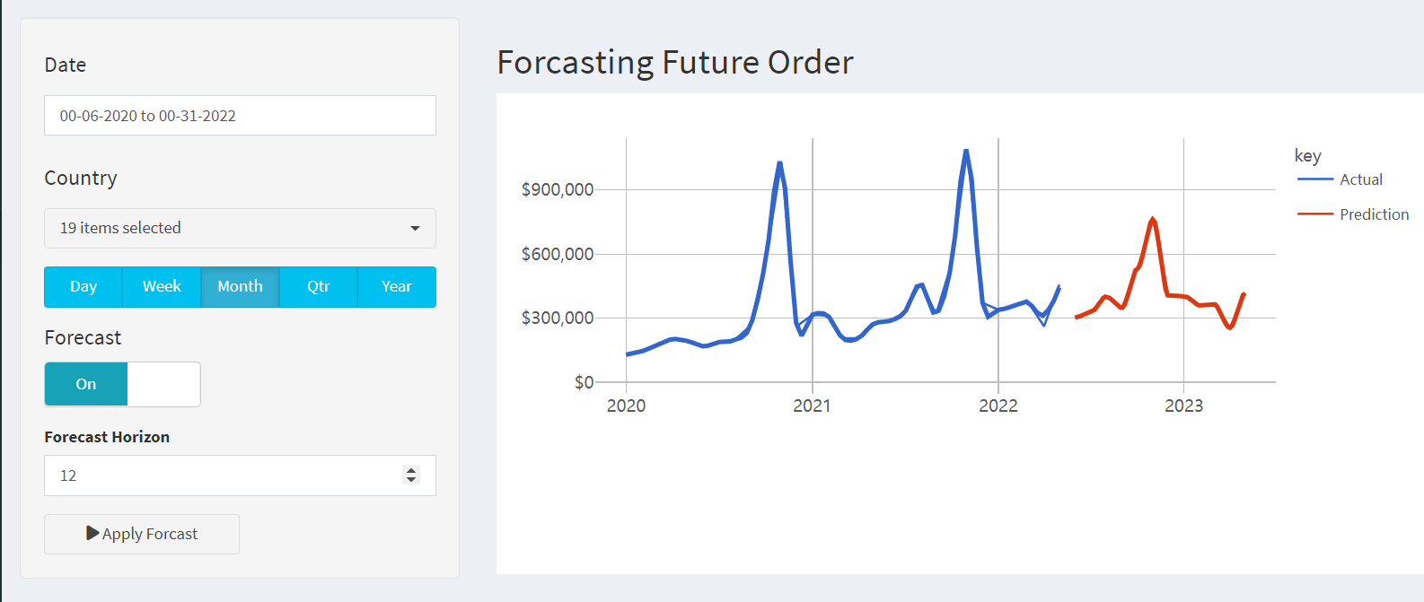
Future Order Forecast
Bibliography
O projekcie
R

Slide 9
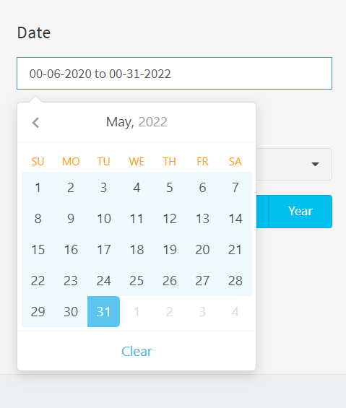
Future Order Forecast
Bibliography
O projekcie
R
shinyWidgets::airDatepickerInput(
inputId = "date_range",
label = h4("Date"),
value = c(min(processed_data_tbl$ORDERDATE),
max(processed_data_tbl$ORDERDATE)),
separator = " to ",
range = TRUE,
minDate = min(processed_data_tbl$ORDERDATE),
maxDate = max(processed_data_tbl$ORDERDATE),
dateFormat = "mm-dd-yyyy",
autoClose = TRUE,
clearButton = TRUE,
width = "100%",
addon = "none"

Slide 10
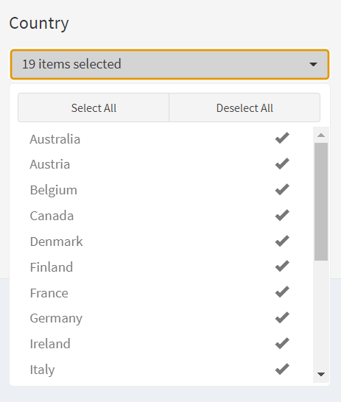
Future Order Forecast
Bibliography
O projekcie
R
shinyWidgets::pickerInput(
inputId = "picker_country",
label = h4("Country"),
choices = sort(unique(processed_data_tbl$COUNTRY)),
selected = unique(processed_data_tbl$COUNTRY),
multiple = TRUE, # Allow multiple options
options = list(
`actions-box` = TRUE, # Note back ticks
size = 10,
`selected-text-format` = "count > 3"

Slide 11
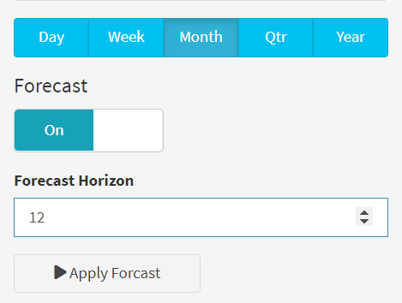
Future Order Forecast
Bibliography
O projekcie
R
conditionalPanel(condition =
"input.forecast_mode == 1",
numericInput(inputId = "n_future",
label = "Forecast Horizon",
value = 12,
min = 1
)),
# APPLY BUTTONS -----
actionButton(inputId = "apply",
label = "Apply Forcast",
icon = icon("play"),
width = '50%')

Slide 12
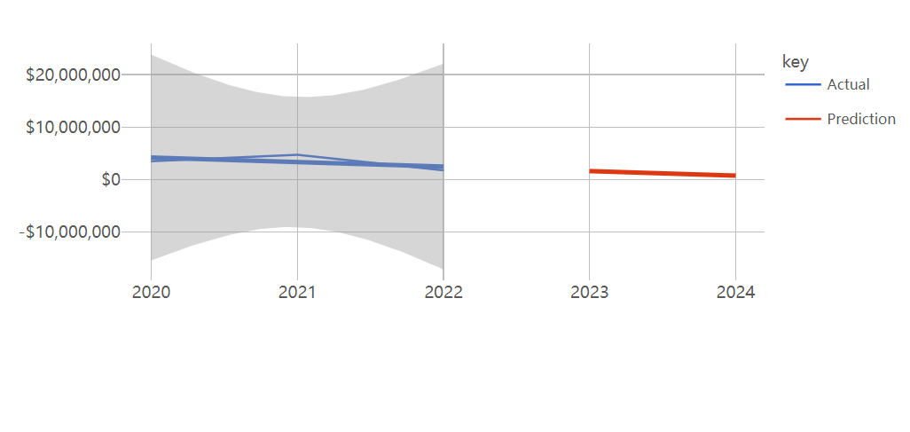
Using linear regression predict year order
Bibliography
O projekcie
R
Month
Day
Predict next 2 years order

Slide 13
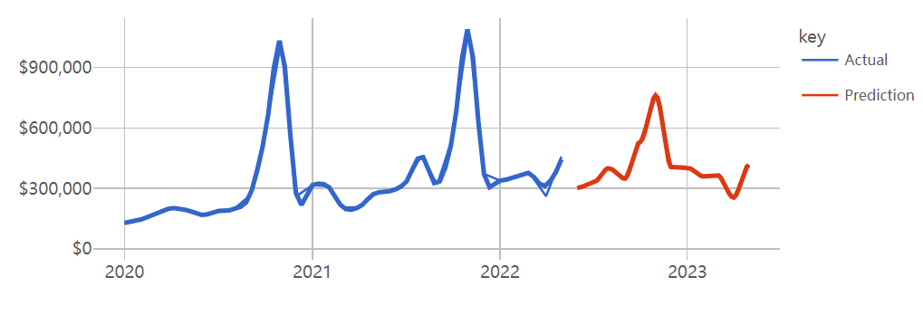
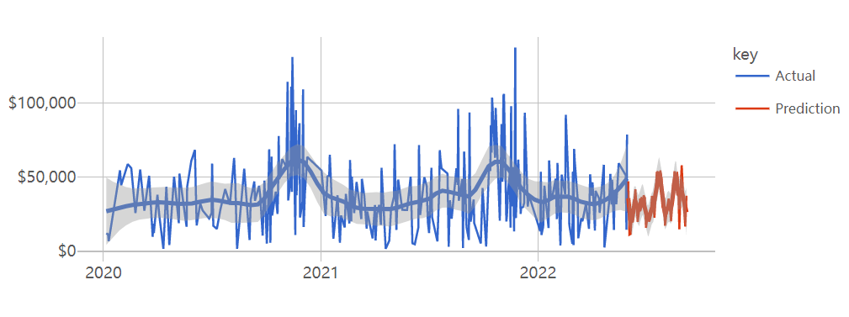
Using gradient boosting machine
Bibliography
O projekcie
R
Month
Day

Slide 14
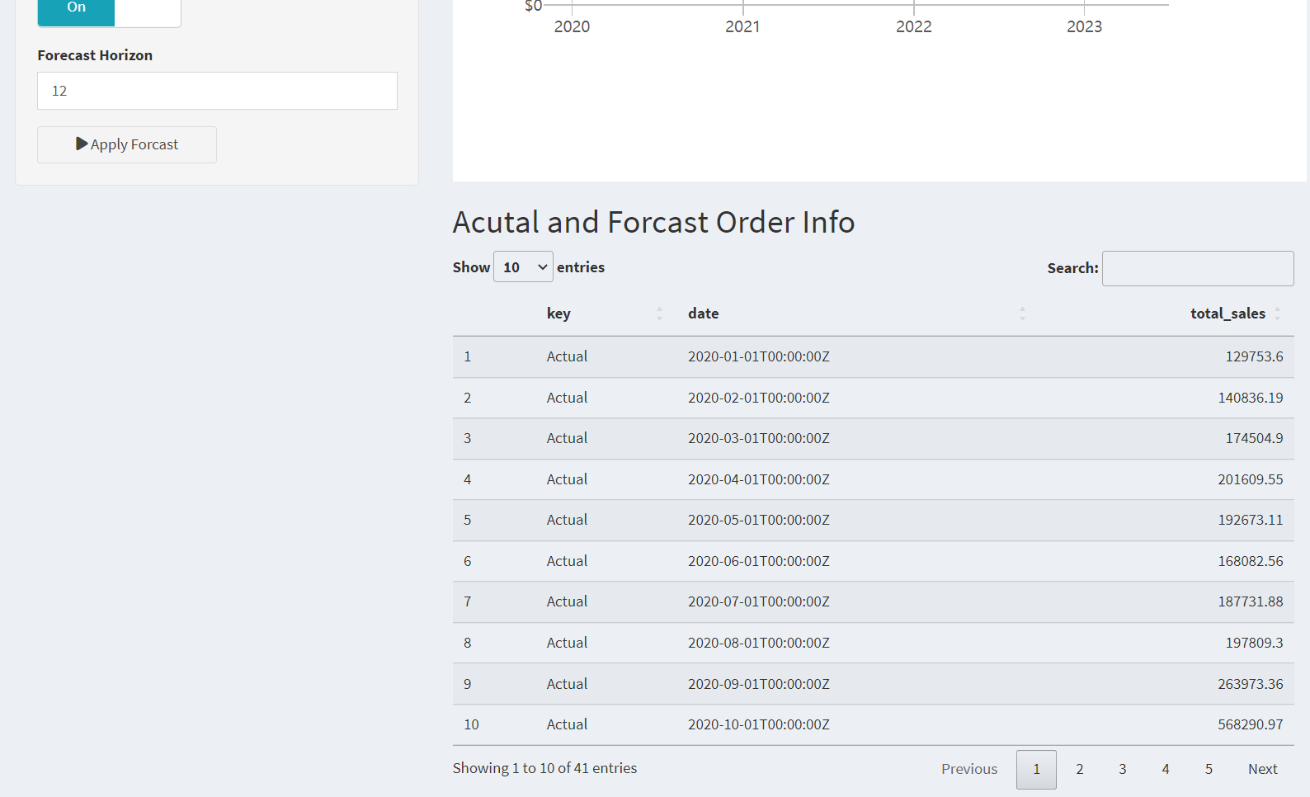
Future Order Forecast details
Bibliography
O projekcie
R

Slide 15
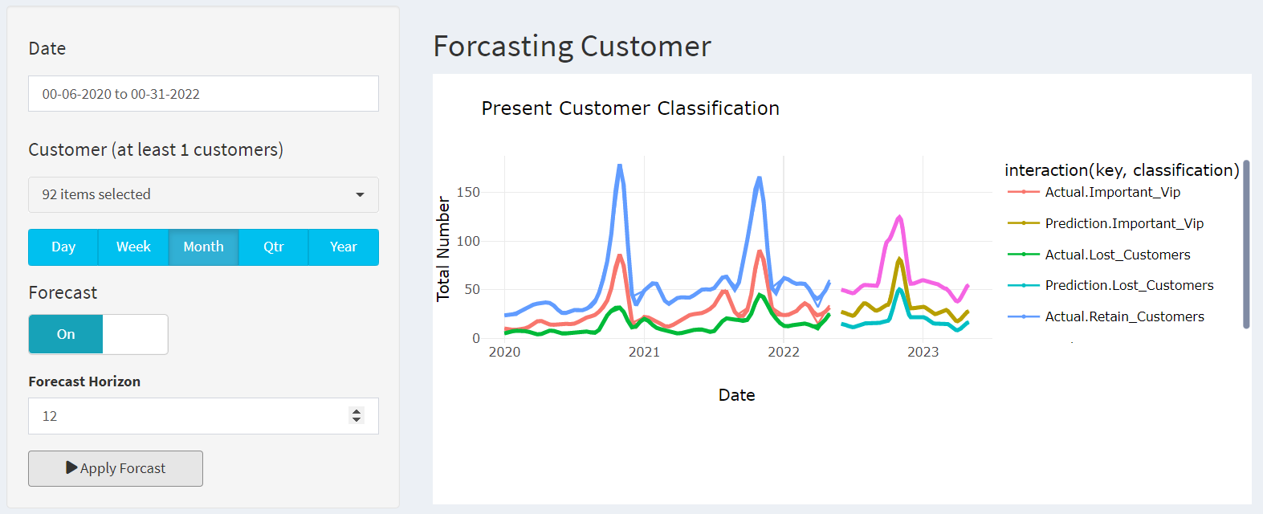
Future Customer Forecast
Bibliography
O projekcie
R
Important VIP Who hold significant value for the business
Lost customer Who have stopped making purchases
Retain customer who continue to engage with the business

Slide 16
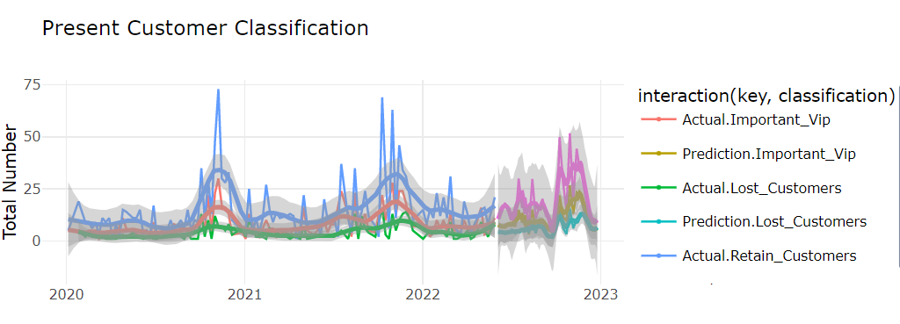
Future Customer Forecast
Bibliography
O projekcie
R
Predict next 30 weeks order

Slide 17
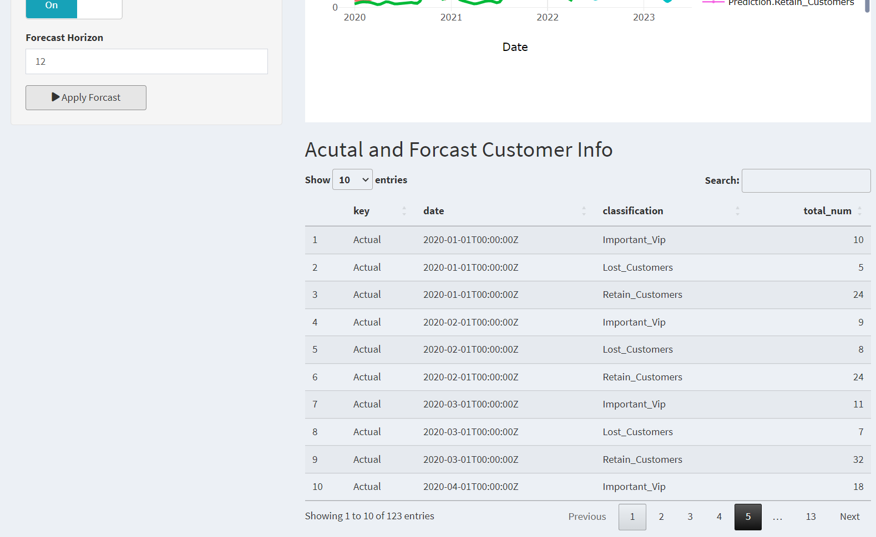
Consumer Forecast
Bibliography
O projekcie
R

